Slide 1
An Introduction To Bayesian Statistics
Simon Thornewill von Essen
Data Analyst, Goodgame Studios
@sthornewillve 🐍

Slide 2


“[Bayesian Stats.] is one of those ideas that seems hard when you first encounter it. Then, at some point there is a breakthrough and then it seems obvious.
Once you’ve got it, it’s such a beautiful idea that it changes how you see everything.”
Prof. Allan Downey, Data Framed, 2018

Slide 3
How do we estimate probability?
Classical: By considering equal outcomes
Frequentist: Relative Frequency over time
Bayesian: By quantifying our uncertainties

Slide 4
Coin Toss: Classical Est.
Coin
|
------
| |
H T
0.5 0.5

Slide 5
Dice: Classical Est.
Dice
|
--------------------------
| | | | | |
1 2 3 4 5 6
0.16 0.16 0.16 0.16 0.16 0.16

Slide 6
Classical Stats
Requirements
All Outcomes are known
Outcomes are assumed to be equally likely
Advantages
Fast Estimation
Easy to understand
Disadvantages
Outcomes must be known
Often created overly simplified models when applied to complex phenomena

Slide 7
How do we estimate probability?
Classical
Frequentist
Take measurements over time
Measurements will eventually approximate the parameter we want to measure
Bayesian

Slide 8
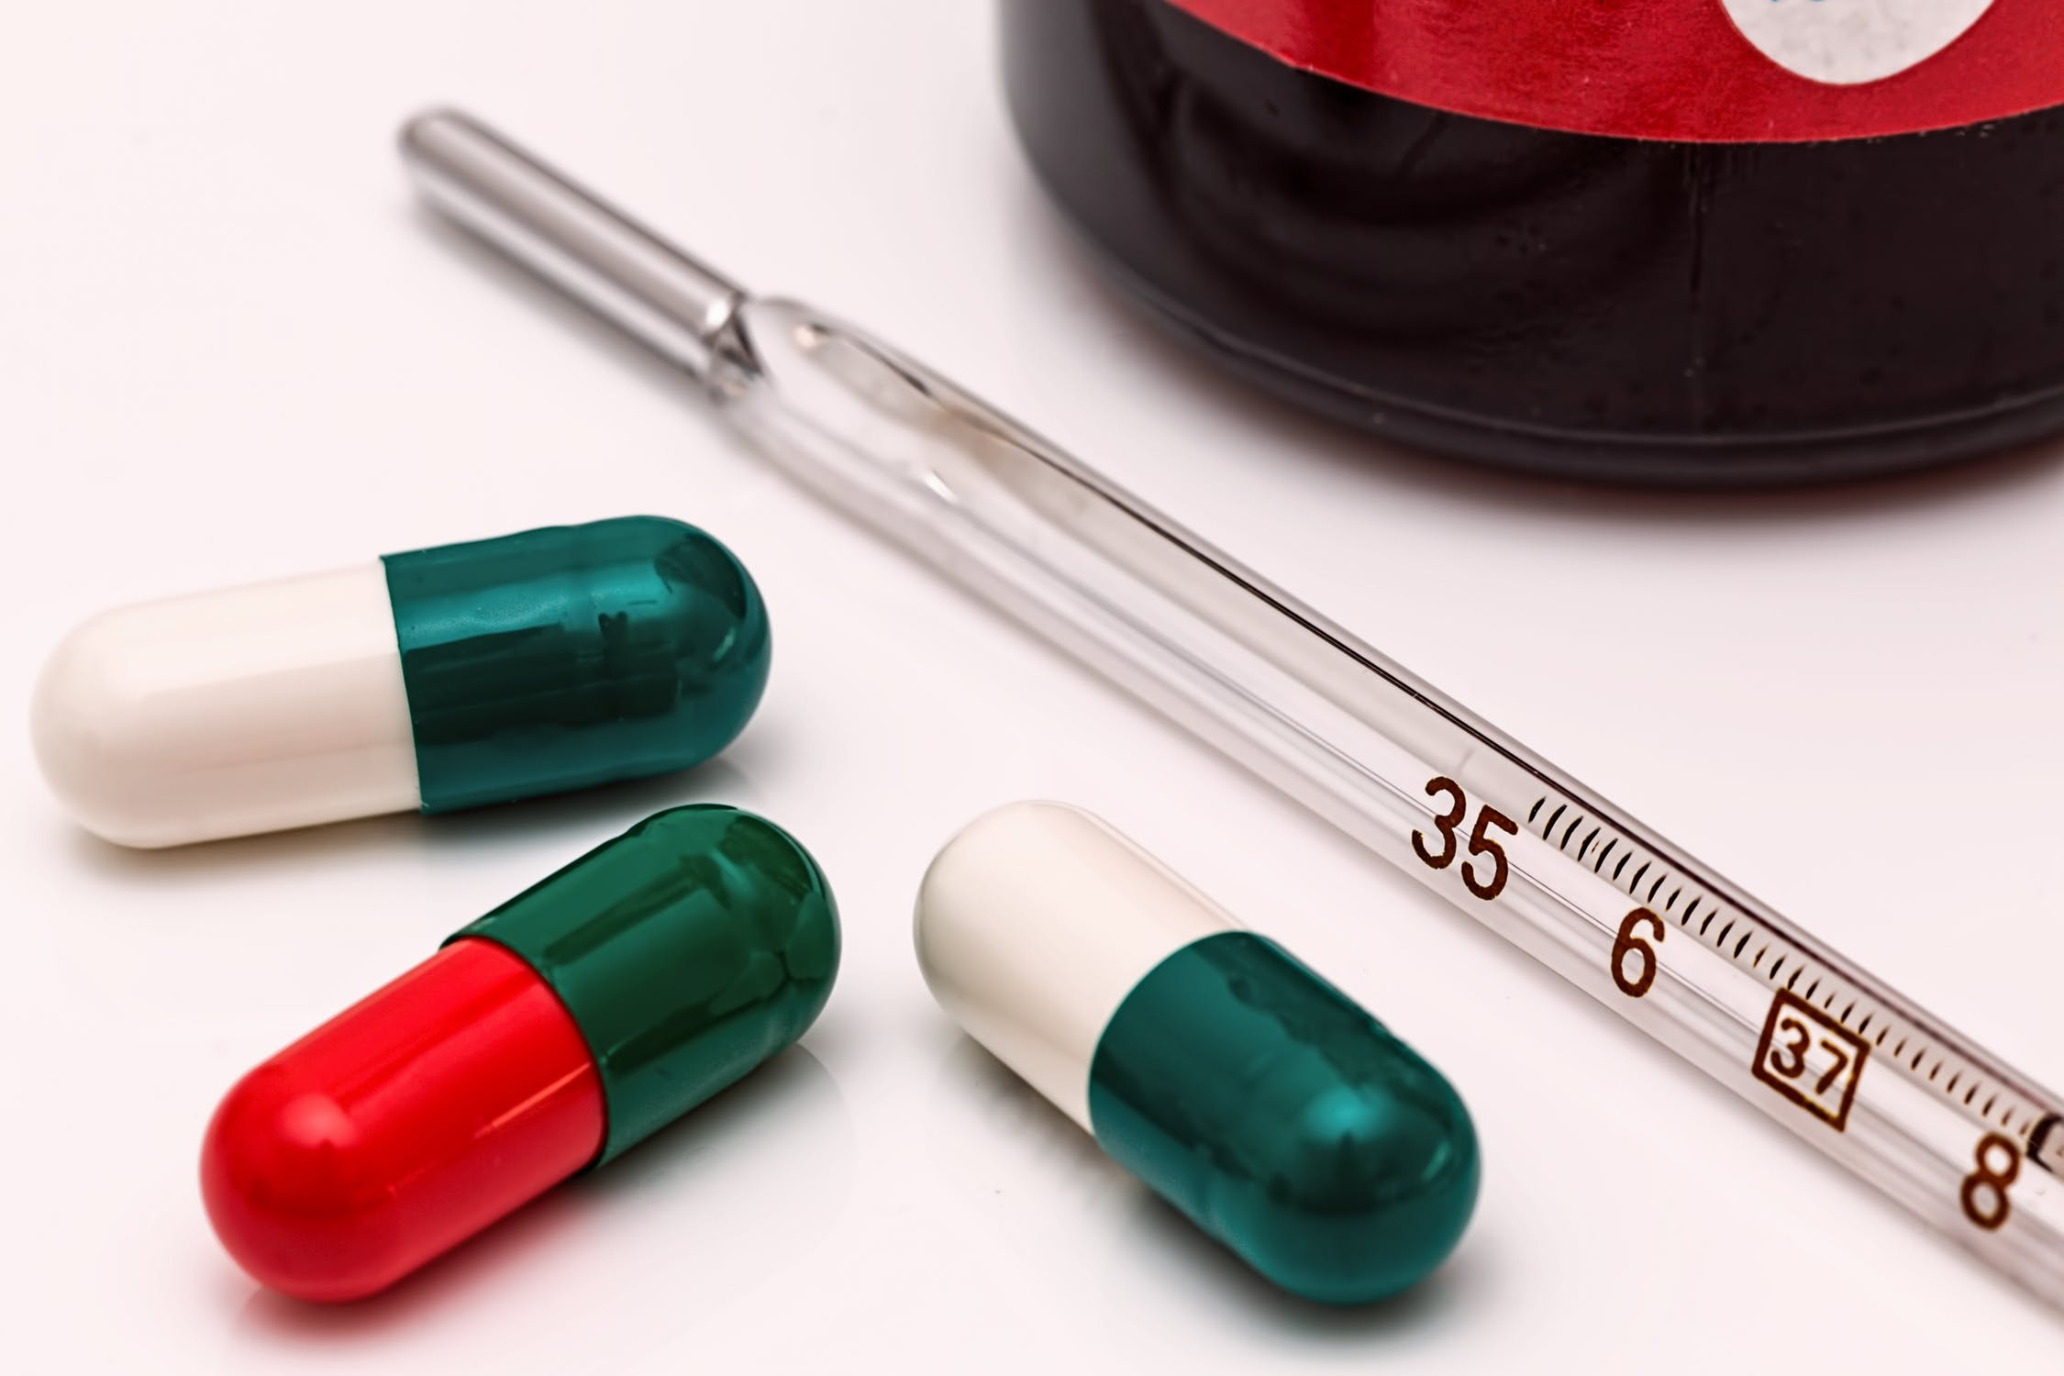
Frequentist Est.
Check to see if thermometer is properly calibrated
Frequentist Approach:
Take many readings and use the expectation value (mean) and std for sample
Calculate the probability of your data given your data following some parameter.

Slide 9
Frequentist Stats
Requirements
Possibility to perform experiments indefinitely
Parameters are assumed to be fixed
Able to estimate params given enough experiments
Advantages
Works well with simulations
“Objective”
Disadvantages
Requires large sample size to be meaningful
Does not allow for integration of domain knowledge
P-values and confidence intervals are unintuitive
Difficult to communicate to non-statisticians

Slide 10
Thermometer Calibration: Test
If P-value = 0.001 (highly significant), is the probability of getting this result or a more extreme one given our data 0.001?
❌
2. For a given confidence interval, does the parameter lie within it 95% of the time?
❌

Slide 11
Thermometer Calibration: Test
If P-value = 0.001 (highly significant), is the probability of getting this result or a more extreme one given our data 0.001? Probability of getting this result getting this result or a more extreme one given a null hypothesis (i.e. no difference in experimental groups) is 0.001
2. For a given confidence interval, does the parameter lie within it 95% of the time? Intervals of repeated experiments will contain the parameter 95% of the time

Slide 12
Thermometer Calibration: Test Learnings
Frequentism expects that parameters exist and are fixed, the probabilities are the likelihood of our data given these expectations
Repeated Experiments
Mean

Slide 13
“Wait, wasn’t this was we were doing with frequentism?”
Repeated Experiments
Given a region
Our parameter will be more or less likely
Mean
Example from J. Vanderplas’s 2014 Scipy Talk

Slide 14

Thermometer Calibration: Test Learnings
Child doesn’t move, your repeated photos contain them 95% of the time

Slide 15
Frequentist Stats Disav. Cont.
What if?
Amount of data you have is limited?
You have relevant and applicable prior information
“Infinite” experiments are not possible? (Cost, feasibility)
Stakeholders have a hard time understanding frequentist logic?
Children never stay still and assuming they do is blasphemy
✅
✅
✅
✅
✅

Slide 16
How do we estimate probability?
Classical
Frequentist
Bayesian

Slide 17
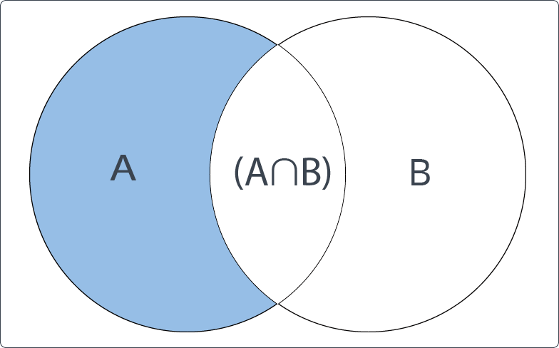

Bayes Theorem: Derivation

Slide 18


Bayes Theorem: Derivation
The Same
∴

Slide 19

Bayes Theorem: Alternate View
𝜃 = Parameter,
X = Data
likelihood
prior
posterior
normalisation

Slide 20
Bayes Theorem: Alternate View
✅
Problem:
How to calculate p(X)
How to calculate p(𝜃)

Slide 21
Bayes Theorem: How to Calculate P(𝜃)?
Create Your Own
Take Previous posterior

Slide 22
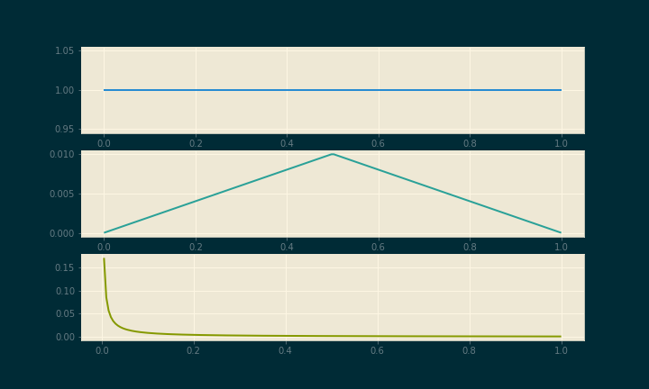
Bayes Theorem: How to Calculate P(𝜃)?
Create Your Own
Take Previous posterior

Slide 23

Bayes Theorem: How to Calculate P(𝜃)?
Problem: Are you Baking your biases into your model?
Notes:
Making Biases explicit
With enough data, bayesian and frequentist likelihoods are equivalent such that priors are “washed out”

Slide 24
Bayes Theorem: How to Calculate P(𝜃)?
Might as well have your explicit and tangible biases.
As the sample size increases, priors get washed out. (As long as you are “reasonable”)
Low Sample Size: Frequentist Stats is börked anyway, so why not?
High Sample Size: Prior Doesn’t matter
“Reasonable” = Cromwell’s Rule
Notes:
Making Biases explicit
With enough data, bayesian and frequentist likelihoods are equivalent such that priors are “washed out”

Slide 25


Bayes Theorem: How to Calculate P(X)?
Sum over all possible hypotheses
This is the hard part
Can be ignored if comparing inside of the same distribution

Slide 26
How!?: Doctor’s Diagnosis
Doctor’s Diagnosis:
You are suspicious you have a rare disease
Disease affects 0.1% of the population
Test is 99% accurate
What is the probability you have this disease given that you tested positive?

Slide 27



How!?: Doctor’s Diagnosis
(9.9 10⁻⁴)
(9.99 10⁻³)

Slide 28
How!?: Doctor’s Diagnosis
Doctor’s Diagnosis:
Works out to be roughly 9% chance of having disease
Rate is lower than expected because disease is so rare
99% is a high accuracy, but not that high
Application: Think about this example next time you build a classifier

Slide 29

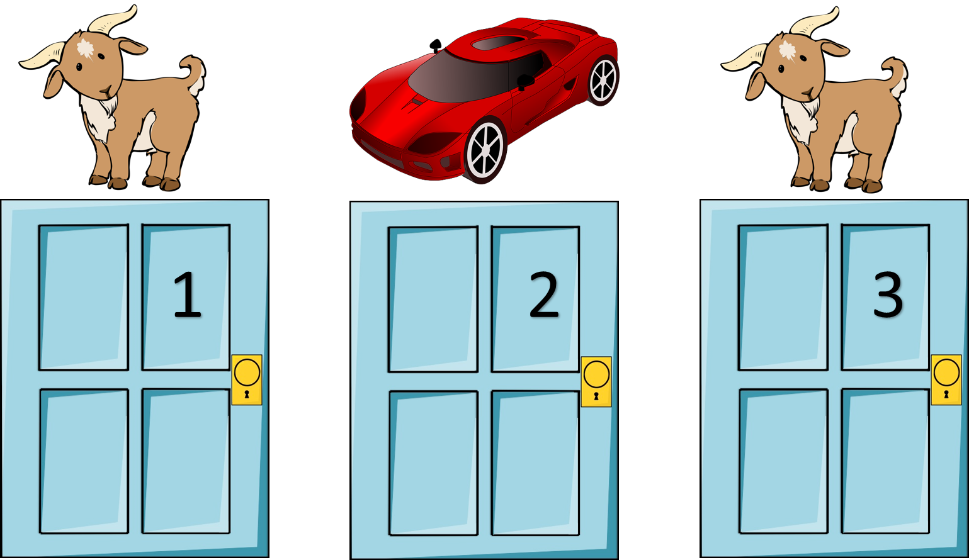
How!?: Monty Hall Problem
The Monty Hall Problem:
You Pick Door 1
Monty opens door 2 to reveal a goat
Should you switch to door 3?

Slide 30
How!?: Monty Hall Problem
Hypothesis i | Prior P(𝜃_{i})
Car Behind 1 | 1/3
Car Behind 2 | 1/3
Car Behind 3 | 1/3

Slide 31
How!?: Monty Hall Problem
Hypothesis i | Likelihood p(X | 𝜃_{i})
Car Behind 1
Car Behind 2
Car Behind 3

Slide 32
How!?: Monty Hall Problem
Hypothesis i | Likelihood p(X | 𝜃_{i})
Car Behind 1 | 1/2
Car Behind 2
Car Behind 3

Slide 33
How!?: Monty Hall Problem
Hypothesis i | Likelihood p(X | 𝜃_{i})
Car Behind 1 | 1/2
Car Behind 2 | 0.0
Car Behind 3

Slide 34
How!?: Monty Hall Problem
Hypothesis i | Prior p(𝜃_{i}) | Likelihood p(X | 𝜃_{i})
Car Behind 1 | 1/3 | 1/2
Car Behind 2 | 1/3 | 0.0
Car Behind 3 | 1/3 | 1.0

Slide 35

How!?: Monty Hall Problem
Hypothesis i | Prior p(𝜃_{i}) | Likelihood p(X | 𝜃_{i}) | Prior * Likelihood
Car Behind 1 | 1/3 | 1/2 | 1/6
Car Behind 2 | 1/3 | 0.0 | 0.0
Car Behind 3 | 1/3 | 1.0 | 2/6
= 1/6 + 0 + 2/6
= 3/6
= 1/2
* This is the Dot Product of p(𝜃_{i}) and p(X | 𝜃_{i})

Slide 36
How!?: Monty Hall Problem
Hypothesis i | Prior p(𝜃_{i}) | Likelihood p(X | 𝜃_{i}) | Prior * Likelihood | Posterior
Car Behind 1 | 1/3 | 1/2 | 1/6 | 1/3
Car Behind 2 | 1/3 | 0.0 | 0.0 | 0.0
Car Behind 3 | 1/3 | 1.0 | 2/6 | 2/3
Key to problem:
Monty does not choose doors at random and so opening a door provides you with information
“Table Method” from A. Downey’s Think Bayes

Slide 37
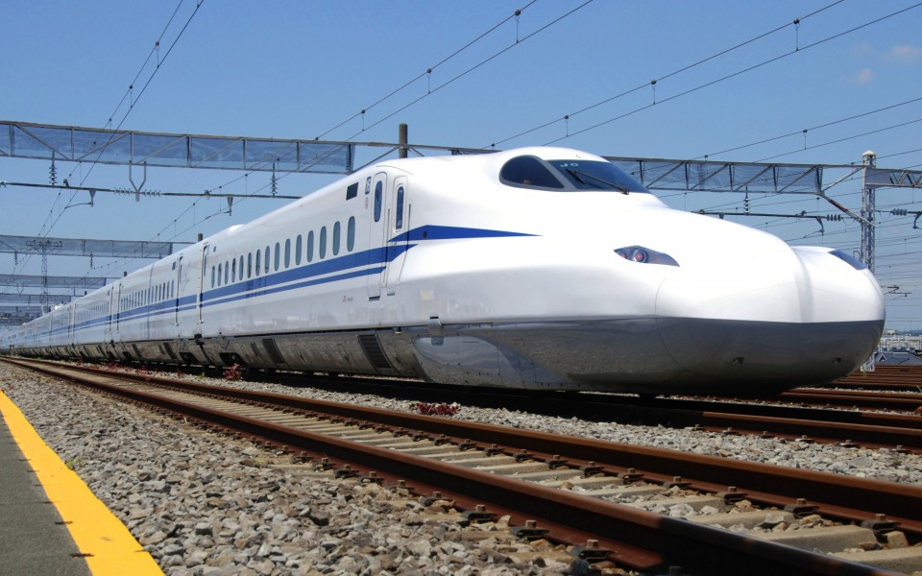
How!?: Train Analysis
You see a train labeled 60 (labels in ascending order of creation)
How many trains does this company own given that you’ve seen #60?

Slide 38
How!?: Train Analysis
Hypothesis i | Prior p(𝜃_{i}) | Likelihood p(X | 𝜃_{i}) | Prior * Likelihood | Posterior
1 Train | 1/1000 | 0.0 | 0.0 | post₁
2 Trains | 1/1000 | 0.0 | 0.0 | post₂
... | ... | ... | ... | ...
60 Trains | 1/1000 | 1/60 | 1/(6*10⁴) | post₆₀
... | ... | ... | ... | ...
1000 Trains | 1/1000 | 1/1000 | 1/10⁶ | post₁₀₀₀
𝚺 = P(Train)

Slide 39
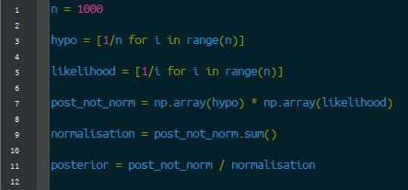
How!?: Train Analysis

Slide 40
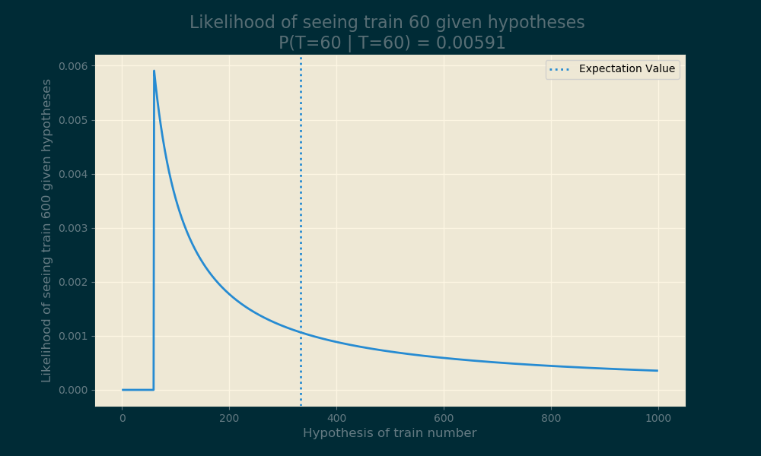
How!?: Train Analysis
MLE
Expectation
What if we change priors?
Posterior changes
What if we increase the max number of trains
Posterior changes
Example from A. Downey’s “Think Bayes”

Slide 41

How!?: Part 1 - Discrete Case Recap
Remember the table calculation!
Steps:
Pick Prior (Often Uniform)
Multiply by Frequentist Likelihood
Divide by Normalisation constant

Slide 42
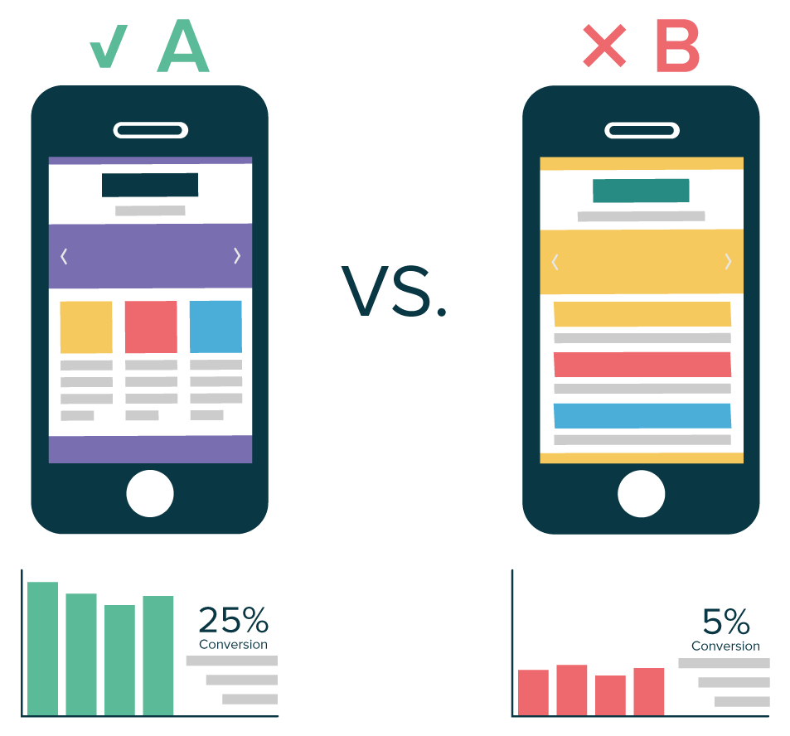
How!?: Part 2 - Continuous Case
AB Testing Revisited:
Two variants
What is the probability of A being better than B?
Time for Bayesian Statistics!

Slide 43
How!?: Part 2 - Continuous Case
Challenges w/ Freq. AB Tests:
Test needs to reach pre-defined sample size
Need to adjust α for multiple tests (Bonferroni Corrections)
People start accepting null hypotheses
Can only reject/fail to reject null hypothesis, (leads to p-hacking)
People peek at tests before tests are over, (moar p-hacking)

Slide 44

How!?: Part 2 - Continuous Case
AB Test:
For people randomly placed in control/test
Track conversions (1/0)
What is our Likelihood?
Bernoulli

Slide 45

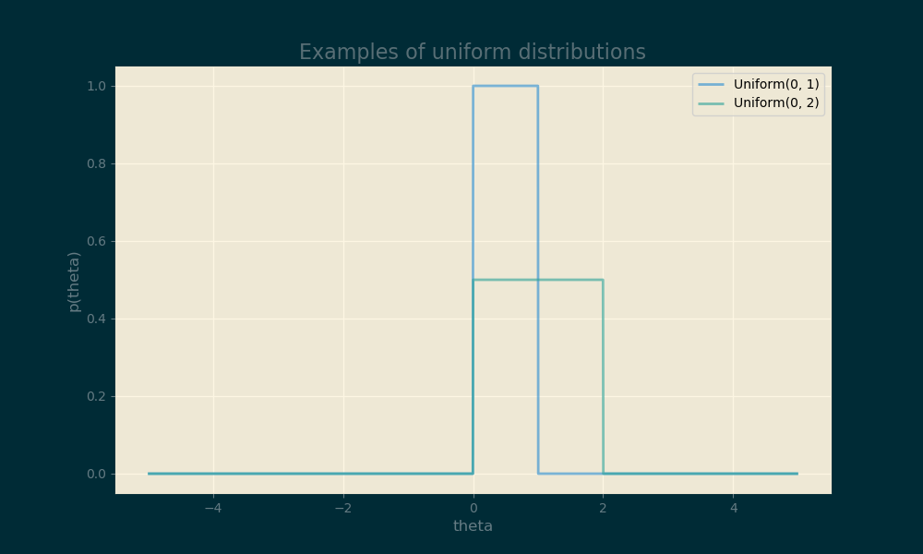
How!?: Part 2 - Continuous Case
Prior?:
Uninformed Prior
Uniform distribution
Represented by Indicator Function

Slide 46
How!?: Part 2 - Continuous Case
Notes:
Quick and Dirty: Multiply Prior by Likelihood

Slide 47

How!?: Part 2 - Continuous Case
Notes:
For accurate, divide by the likelihood of the data at each point
Integral is gnarly, but we can make it equal to 1 to make it disappear

Slide 48


How!?: Part 2 - Continuous Case
Notes:
Make integral equal to one by adding A coefficient

Slide 49

How!?: Part 2 - Continuous Case
Notes:
Equation simplifies massively

Slide 50


How!?: Part 2 - Continuous Case
Notes:
Et Voila. A function that is easy to import from numpy

Slide 51
Conjugate Priors
Beta distribution is example of conj. Prior
Use it and you will get the same distribution in posterior
Once the math is done, never do it again
Update functions using data as it appears
See more Conj. Priors in U. of Santa Cruz’s Coursera Course

Slide 52
Conjugate Priors
https://en.wikipedia.org/wiki/Conjugate_prior#Table_of_conjugate_distributions
(Just Google “conjugate priors table wikipedia”)

Slide 53
Conjugate Priors
https://en.wikipedia.org/wiki/Conjugate_prior#Table_of_conjugate_distributions
(Just Google “conjugate priors table wikipedia”)

Slide 54

How!?: Part 2 - Continuous Case Recap
Steps:
Pick Prior (Often Uniform)
Multiply by Frequentist Likelihood
Divide by Normalisation constant
Integral over all possible hypotheses
(Tips and tricks may be required)
If you’re lucky, you can use a conjugate prior for updates

Slide 55
Demo:
Conjugate Priors
https://seeing-theory.brown.edu/bayesian-inference/index.html

Slide 56
Posteriors - What Now?
Do we calculate P-values now?
No need, just calculate P(𝜃₂ > 𝜃₁)
Takes some calculation, but the result is nicer
Can we peek at results or stop at any time?
Yes!
More from Nora Neumann @ Pydata 2016 on YouTube

Slide 57
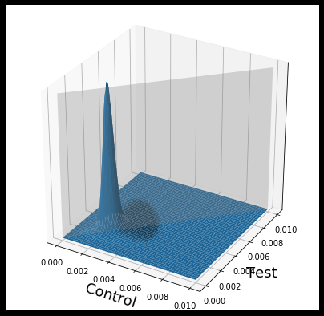
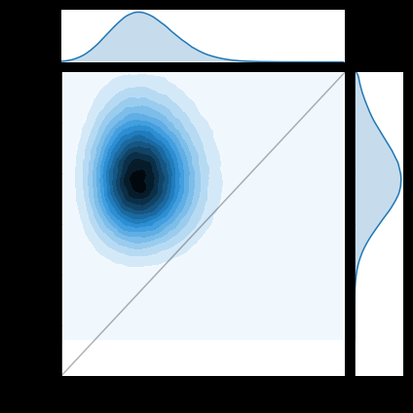
Posteriors - What Now?
More from Vincenzo Lavorini @ “Bayesian A/B Testing with Python: the easy guide” Towards Data Science

Slide 58
Demo:
Bayesian AB Testing

Slide 59
Bayesian Stats
Advantages
Estimation in the case of little data (specific circumstances)
Parameters are distributions
Probabilistic answers answer questions people tend to have
Disadvantages
Steeper learning curve
Integrals are hard (MCMC computationally expensive)
Criticisms of being less “objective” due to use of priors
Point estimates become the same as frequentist estimations with high sample sizes

Slide 60
How do we estimate probability?
Classical: By considering equal outcomes
Frequentist: Relative Frequency over time
Bayesian: By quantifying our uncertainties

Slide 61
How do we estimate probability?
Classical: By considering equal outcomes
Frequentist: Relative Frequency over time
Bayesian: By quantifying our uncertainties
There is only one field of statistics
Notes:
Don’t get tribal about Freq. vs Bayes. (It’s banter, its funny, but not serious)

Slide 62
Conclusion and “Call to Action”
Understanding Bayes vs Freq. is key to understanding a lot of the field stats
Beginner scientists: Check my sources as a jump off point
Experienced scientists: Come and tell me how you applied this knowledge
Decision-makers: Be aware of these kinds of analyses and when the strengths benefit your use-case.
General Advice: Try to think about conditional probability more often (doctor’s diagnosis) in relation to drawing conclusions

Slide 63
Resources for further learning
Mathematical Understanding: “Bayesian Stats: From Concept to Data Analysis”, U of Santa Cruz
Intuition between Bayesianism & Frequentism: “Frequentism and Bayesianism”, Scipy - Jake Vander Plas
Examples of Real World Applications: “Think Bayes”, Allan Downey
Further reading into MCMC and pyMC: “Bayesian Methods for Hackers”, Cameron Davidson-Pilon

Slide 64
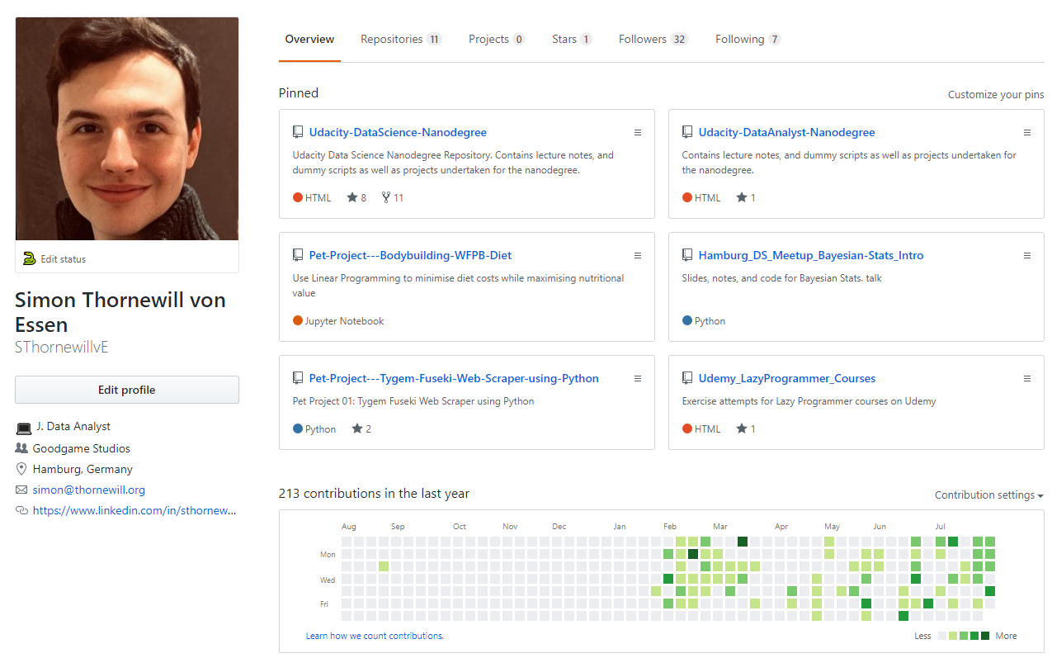

Find Slides on Github
https://cutt.ly/zGqux9

Slide 65
Fin!
@sthornewillve

Slide 66

Frequentist Est.: Confidence Intervals
Confidence Interval:
From sample mean and standard deviation, calculate an interval
Upon repeated experiments, intervals contain the true parameter x% of the time

Slide 67
Frequentist Est.: Confidence Intervals
CI Intuition::
bootstrap CI n times -> intervals would contain the mean of population 95% of the time

Slide 68
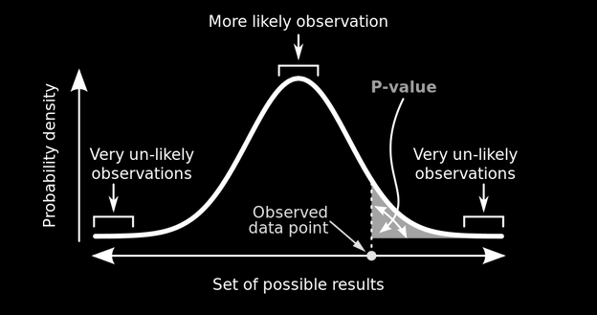
Frequentist Est.: P-Values
P-value:
Probability of seeing data given a parameter

